Slide 1

Chapter 8 Security
A note on the use of these PowerPoint slides:
We’re making these slides freely available to all (faculty, students, readers). They’re in PowerPoint form so you see the animations; and can add, modify, and delete slides (including this one) and slide content to suit your needs. They obviously represent a lot of work on our part. In return for use, we only ask the following:
If you use these slides (e.g., in a class) that you mention their source (after all, we’d like people to use our book!)
If you post any slides on a www site, that you note that they are adapted from (or perhaps identical to) our slides, and note our copyright of this material.
For a revision history, see the slide note for this page.
Thanks and enjoy! JFK/KWR
All material copyright 1996-2020
J.F Kurose and K.W. Ross, All Rights Reserved
Computer Networking: A Top-Down Approach 8th edition Jim Kurose, Keith Ross Pearson, 2020
Notes:
Version History
8.0 (May 2020)
All slides reformatted for 16:9 aspect ratio
All slides updated to 8th edition material
Use of Calibri font, rather that Gill Sans MT
Add LOTS more animation throughout
lighter header font
wireless security completely redone (updated WiFi and added 4G/5G)
SSL material replaces by TLS 1.3 (up-to-date)

Slide 2
Security: overview
Chapter goals:
understand principles of network security:
cryptography and its many uses beyond “confidentiality”
authentication
message integrity
security in practice:
firewalls and intrusion detection systems
security in application, transport, network, link layers

Slide 3

Chapter 8 outline
What is network security?
Principles of cryptography
Message integrity, authentication
Securing e-mail
Securing TCP connections: TLS
Network layer security: IPsec
Security in wireless and mobile networks
Operational security: firewalls and IDS

Slide 4

What is network security?
CIA
confidentiality: only sender, intended receiver should “understand” message contents
sender encrypts message
receiver decrypts message
authentication: sender, receiver want to confirm identity of each other
message integrity: sender, receiver want to ensure message not altered (in transit, or afterwards) without detection
access and availability: services must be accessible and available to users

Slide 5



Friends and enemies: Alice, Bob, Trudy
well-known in network security world
Bob, Alice (lovers!) want to communicate “securely”
Trudy (intruder) may intercept, delete, add messages
Alice
channel
data, control messages
Bob
secure
sender
secure
receiver
data
data
Trudy

Slide 6
Friends and enemies: Alice, Bob, Trudy
Who might Bob and Alice be?
… well, real-life Bobs and Alices!
Web browser/server for electronic transactions (e.g., on-line purchases)
on-line banking client/server
DNS servers
BGP routers exchanging routing table updates
other examples?

Slide 7
There are bad guys (and girls) out there!
Q: What can a “bad guy” do?
A: A lot! (recall section 1.6)
eavesdrop: intercept messages
actively insert messages into connection
impersonation: can fake (spoof) source address in packet (or any field in packet)
hijacking: “take over” ongoing connection by removing sender or receiver, inserting himself in place
denial of service: prevent service from being used by others (e.g., by overloading resources)

Slide 8
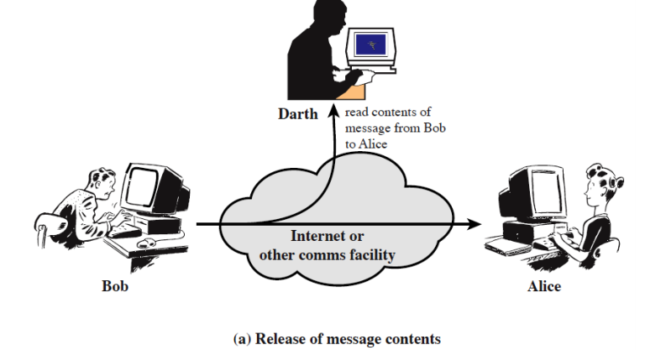
Passive Attack (1) Eavesdrop

Slide 9
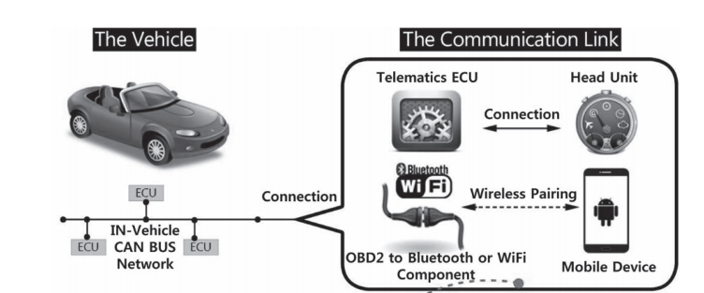
Passive Attack (1) Eavesdrop
No longer popular, as most data going through the Internet are encrypted!
Some IoT system may still suffer

Slide 10
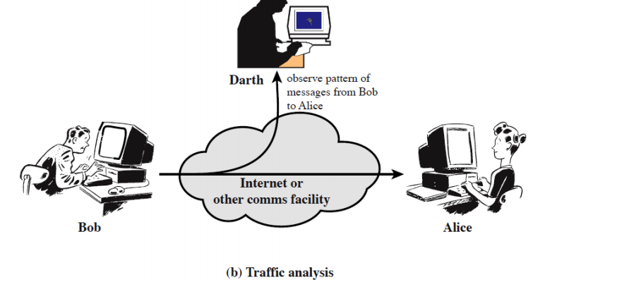
Passive Attack (2) Traffic Analysis
Even for encrypted data!

Slide 11
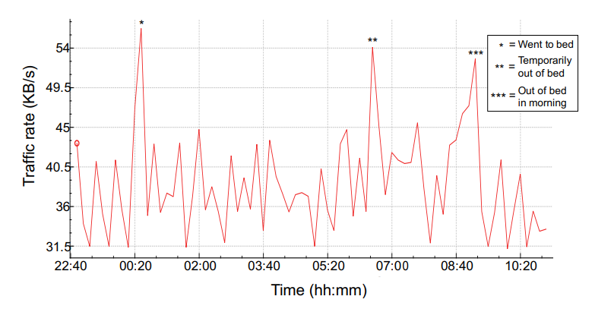
Traffic Analysis Example
“Spying on the smart home: Privacy attacks and defenses on encrypted IoT traffic”
Notes:
Research from Princeton, published in year 2017,

Slide 12
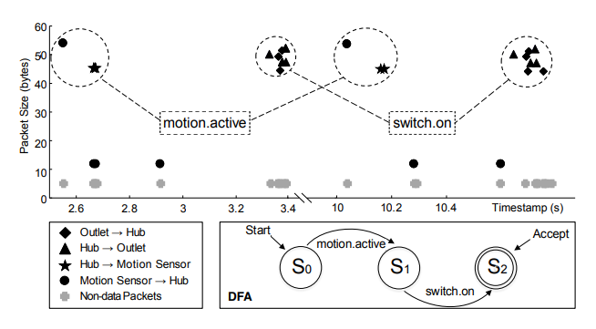
Traffic Analysis Example
“HoMonit: Monitoring Smart Home Apps from Encrypted Traffic”, CCS’18
Notes:
Brighten My Path is a SmartApp for automatically turning on the outlet after a motion has been detected by the motion sensor
motion.active corresponds to packet sequence (54 ↑) and switch.on corresponds to packet sequence (50 ↓, 47 ↓, 47 ↓, 52 ↓),

Slide 13
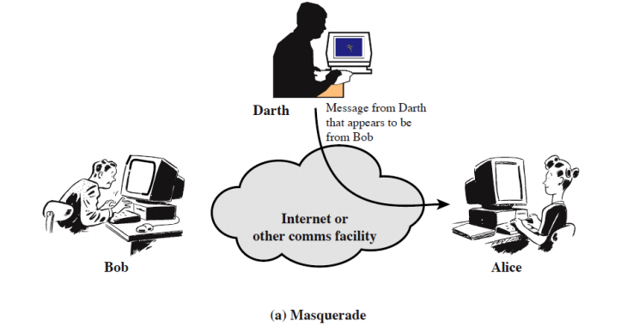
Active attack (1) - spoofing

Slide 14
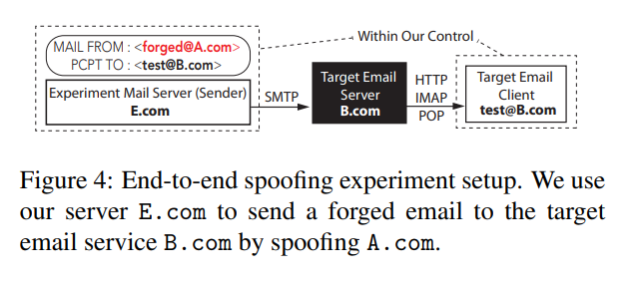
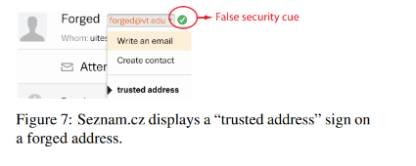
Email Spoofing Attack
End-to-End Measurements of Email Spoofing Attacks, UsenixSecurity’18
Conclusion: We demonstrate that most email providers allow forged emails to get to user inbox, while lacking the necessary warning mechanism to notify users (particularly on mobile apps).

Slide 15
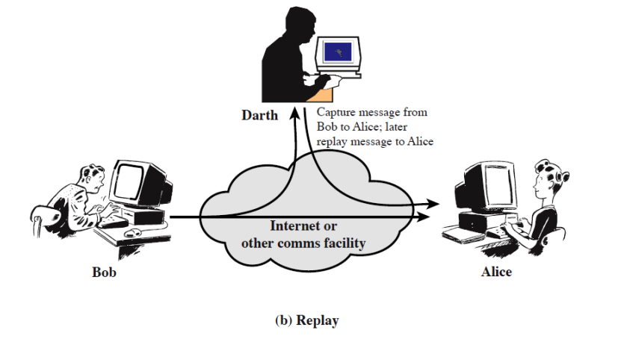
Active (2) – replay (similar to man in the middle attack)

Slide 16
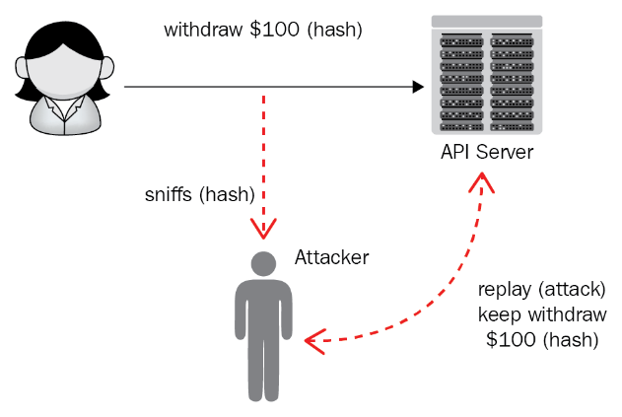
Replay Attacks
Usually integrated with Sniffing (eavesdropping )
Notes:
The legitimate user sends a valid request, but the attacker spoofs it and resends/replays it to the APIs.
As RESTful APIs are stateless, the attacker can keep withdraw caches.
How to prevent replay attacks？Add some randomness for each communication. For example, add a timestamp for each withdraw, or use a password for each transaction that’s only used once and discarded.

Slide 17
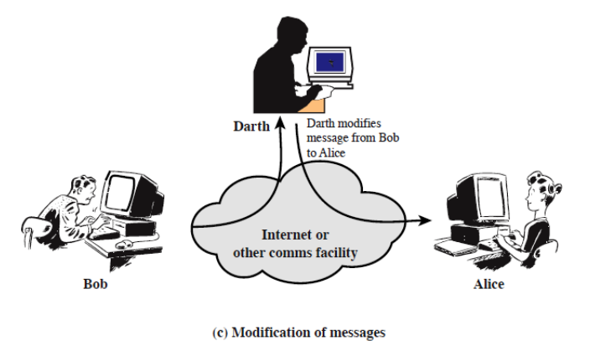
Active (3) – intercept & modify
Man in the middle attack!

Slide 18
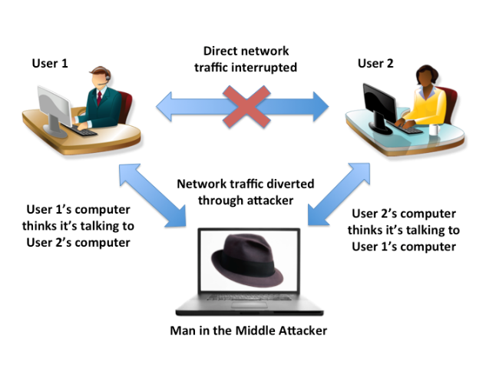
Man in the Middle Attack
Attacker pretends to be the sender/receiver

Slide 19

Is this right?
What is the difference between MITM & Eavesdropping?
Notes:
The picture is actually demonstrating eavesdropping

Slide 20
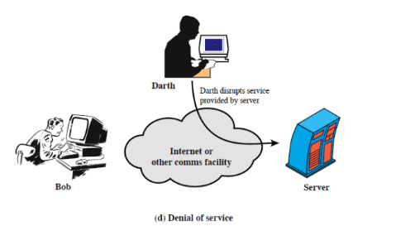
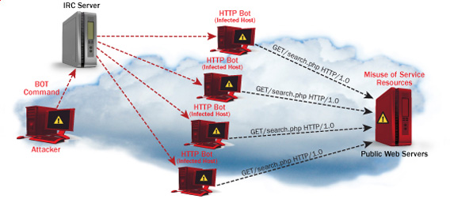
Active (4) - DoS
Notes:
Amazon Web Services (AWS) reports that in February 2020, they defended against a 2.3 -terabit-per-second (Tbps) distributed denial of service (DDoS) attack!
In Q1 2020, a known UDP reflection vector, CLDAP reflection, was observed with a previously unseen volume of 2.3 Tbps. This is approximately 44% larger than any network volumetric event previously detected on AWS. CLDAP reflection attacks of this magnitude caused 3 days of elevated threat during a single week in February 2020 before subsiding. Despite this observation, smaller network volumetric events are far more common. The 99th percentile event in Q1 2020 was 43 Gbps.”

Slide 21
Chapter 8 outline
What is network security?
Principles of cryptography
Message integrity, authentication
Securing e-mail
Securing TCP connections: TLS
Network layer security: IPsec
Security in wireless and mobile networks
Operational security: firewalls and IDS

Slide 22
The language of cryptography
Alice’s
encryption
key
Bob’s
decryption
key
K
A
K
B
plaintext
encryption
algorithm
ciphertext
decryption
algorithm
plaintext
m: plaintext message
K_{A}(m): ciphertext, encrypted with key K_{A}
m = K_{B}(K_{A}(m))
Notes:
Note: encrypted data sent over unsecure channels. But that is what encryption is for so that you can transmit data securely across unsecure channels.

Slide 23
Breaking an encryption scheme
cipher-text only attack: Trudy has ciphertext she can analyze
two approaches:
brute force: search through all keys
statistical analysis
known-plaintext attack: Trudy has plaintext corresponding to ciphertext
e.g., in monoalphabetic cipher, Trudy determines pairings for a,l,i,c,e,b,o,
chosen-plaintext attack: Trudy can get ciphertext for chosen plaintext

Slide 24
Symmetric key cryptography
K
K
S
S
plaintext
encryption
algorithm
ciphertext
decryption
algorithm
plaintext
K (m)
S
symmetric key crypto: Bob and Alice share same (symmetric) key: K
e.g., key is knowing substitution pattern in mono alphabetic substitution cipher
Q: how do Bob and Alice agree on key value?
Notes:
Symmetric key is much faster/better performance and thus is good for IoT devices→ not as computationally intensive as with Asymmetric key encryption.

Slide 25
Simple encryption scheme (Caesar Cypher)
substitution cipher: substituting one thing for another
monoalphabetic cipher: substitute one letter for another
plaintext: abcdefghijklmnopqrstuvwxyz
ciphertext: mnbvcxzasdfghjklpoiuytrewq
e.g.:
Plaintext: bob. i love you. alice
ciphertext: nkn. s gktc wky. mgsbc
Encryption key: mapping from set of 26 letters
to set of 26 letters
Notes:
NOTE: YOU SHOULD ALWAYS ASSUME THE ATTACKER KNOWS THE ENCRYPTION MECHANISM → HOW TO GENERATE A KEY

Slide 26
A more sophisticated encryption approach
n substitution ciphers, M₁,M₂,…,M_{n}
cycling pattern:
e.g., n=4: M₁,M₃,M₄,M₃,M₂; M₁,M₃,M₄,M₃,M₂; ..
for each new plaintext symbol, use subsequent substitution pattern in cyclic pattern
dog: d from M₁, o from M₃, g from M₄
Encryption key: n substitution ciphers, and cyclic pattern
key need not be just n-bit pattern

Slide 27
Symmetric key crypto: DES
DES: Data Encryption Standard
US encryption standard [NIST 1993]
56-bit symmetric key, 64-bit plaintext input
block cipher with cipher block chaining
how secure is DES?
DES Challenge: 56-bit-key-encrypted phrase decrypted (brute force) in less than a day
no known good analytic attack
making DES more secure:
3DES: encrypt 3 times with 3 different keys

Slide 28
AES: Advanced Encryption Standard
symmetric-key NIST standard, replaced DES (Nov 2001)
processes data in 128 bit blocks
128, 192, or 256 bit keys
brute force decryption (try each key) taking 1 sec on DES, takes 149 trillion years for AES
Notes:
AES replaced DES.
AES is very efficient as well (as it is a symmetric key algorithm).

Slide 29

Public Key Cryptography
symmetric key crypto:
requires sender, receiver know shared secret key
Q: how to agree on key in first place (particularly if never “met”)?
public key crypto
radically different approach [Diffie-Hellman76, RSA78]
sender, receiver do not share secret key
public encryption key known to all
private decryption key known only to receiver

Slide 30
Public Key Cryptography
+
Bob’s public key
K
B
-
Bob’s private key
K
B
plaintext
message, m
encryption
algorithm
ciphertext
decryption
algorithm
plaintext
+
-
+
K (m)
m = K (K (m))
B
B
B
Wow - public key cryptography revolutionized 2000-year-old (previously only symmetric key) cryptography!
similar ideas emerged at roughly same time, independently in US and UK (classified)
Notes:
Public key does not guarantee authentication but only Confidentiality; Symmetric keys provide both but of course authentication is still vulnerable to man in the middle attacks if a middle man knows the key.

Slide 31
Public key encryption algorithms
requirements:
+
.
-
.
1
need K ( ) and K ( ) such that
B
B
-
+
K (K (m)) = m
B
B
+
2
given public key K , it should be impossible to compute private key K
B
-
B
RSA: Rivest, Shamir, Adelson algorithm

Slide 32
Prerequisite: modular arithmetic
x mod n = remainder of x when divide by n
facts:
[(a mod n) + (b mod n)] mod n = (a+b) mod n
[(a mod n) - (b mod n)] mod n = (a-b) mod n
[(a mod n) * (b mod n)] mod n = (a*b) mod n
thus
(a mod n)^{d} mod n = a^{d} mod n
example: x=14, n=10, d=2: (x mod n)^{d} mod n = 4² mod 10 = 6 x^{d} = 14² = 196 x^{d} mod 10 = 6

Slide 33
RSA: getting ready
message: just a bit pattern
bit pattern can be uniquely represented by an integer number
thus, encrypting a message is equivalent to encrypting a number
example:
m= 10010001. This message is uniquely represented by the decimal number 145.
to encrypt m, we encrypt the corresponding number, which gives a new number (the ciphertext).

Slide 34
RSA: Creating public/private key pair
1. choose two large prime numbers p, q. (e.g., 1024 bits each)
2. compute n = pq, z = (p-1)(q-1)
3. choose e (with e<n) that has no common factors with z (e, z are “relatively prime”).
4. choose d such that ed-1 is exactly divisible by z. (in other words: ed mod z = 1 ).
5. public key is (n,e). private key is (n,d).
+
-
K
K
B
B

Slide 35
RSA: encryption, decryption
0. given (n,e) and (n,d) as computed above
1. to encrypt message m (<n), compute
e
c = m mod n
2. to decrypt received bit pattern, c, compute
d
m = c mod n
magic happens!
e
d
m = (m mod n)
mod n
c
Notes:
Much more computationally intensive (asymmetric/public key) than symmetric key.

Slide 36
RSA example:
Bob chooses p=5, q=7. Then n=35, z=24.
e=5 (so e, z relatively prime).
d=29 (so ed-1 exactly divisible by z).
encrypting 8-bit messages.
m
e
e
bit pattern
m
c = m mod n
encrypt:
0000l000
12
24832
17
d
d
c
c
m = c mod n
decrypt:
17
481968572106750915091411825223071697
12

Slide 37
Why does RSA work?
must show that c^{d} mod n = m, where c = m^{e} mod n
fact: for any x and y: x^{y} mod n = x^{(y mod z)} mod n
where n= pq and z = (p-1)(q-1)
thus, c^{d} mod n = (m^{e} mod n)^{d} mod n
= m^{ed} mod n
= m^{(ed mod z)} mod n
= m¹ mod n
= m

Slide 38
RSA: another important property
The following property will be very useful later:
-
+
+
-
K (K (m)) = m
=
K (K (m))
B
B
B
B
use public key first, followed by private key
use private key first, followed by public key
result is the same!

Slide 39
Why
-
+
+
-
K (K (m)) = m
=
K (K (m))
?
B
B
B
B
follows directly from modular arithmetic:
(m^{e} mod n)^{d} mod n = m^{ed} mod n
= m^{de} mod n
= (m^{d} mod n)^{e} mod n

Slide 40
Why is RSA secure?
suppose you know Bob’s public key (n,e). How hard is it to determine d?
essentially need to find factors of n without knowing the two factors p and q
fact: factoring a big number is hard
Notes:
Note because RSA public (asymmetric) key algorithm is so slow, it mostly used to encrypt and negotiate the symmetric keys between two hosts.

Slide 41
RSA in practice: session keys
exponentiation in RSA is computationally intensive
DES is at least 100 times faster than RSA
use public key crypto to establish secure connection, then establish second key – symmetric session key – for encrypting data
session key, K_{S}
Bob and Alice use RSA to exchange a symmetric session key K_{S}
once both have K_{S}, they use symmetric key cryptography

Slide 42
Chapter 8 outline
What is network security?
Principles of cryptography
Authentication, message integrity
Securing e-mail
Securing TCP connections: TLS
Network layer security: IPsec
Security in wireless and mobile networks
Operational security: firewalls and IDS

Slide 43
Authentication
Goal: Bob wants Alice to “prove” her identity to him
Protocol ap1.0: Alice says “I am Alice”
“I am Alice”
failure scenario??

Slide 44
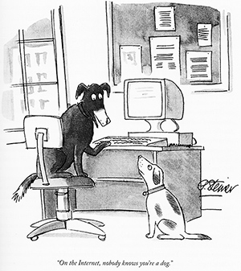
Authentication
Goal: Bob wants Alice to “prove” her identity to him
Protocol ap1.0: Alice says “I am Alice”
in a network, Bob can not “see” Alice, so Trudy simply declares herself to be Alice
“I am Alice”

Slide 45
Authentication: another try
Goal: Bob wants Alice to “prove” her identity to him
Protocol ap2.0: Alice says “I am Alice” in an IP packet containing her source IP address
Alice’s
IP address
“I am Alice”
failure scenario??

Slide 46
Authentication: another try
Goal: Bob wants Alice to “prove” her identity to him
Protocol ap2.0: Alice says “I am Alice” in an IP packet containing her source IP address
Trudy can create
a packet “spoofing”
Alice’s address
Alice’s
IP address
“I am Alice”
Notes:
Spoof: pretend to be someone you are not.

Slide 47
Authentication: a third try
Goal: Bob wants Alice to “prove” her identity to him
Protocol ap3.0: Alice says “I am Alice” Alice says “I am Alice” and sends her secret password to “prove” it.
Alice’s
IP addr
Alice’s
password
“I am Alice”
failure scenario??
Alice’s
IP addr
OK

Slide 48
Authentication: a third try
Goal: Bob wants Alice to “prove” her identity to him
Protocol ap3.0: Alice says “I am Alice” Alice says “I am Alice” and sends her secret password to “prove” it.
playback attack: Trudy records Alice’s packet
and later
plays it back to Bob; now Trudy can still spoof.
Alice’s
IP addr
Alice’s
password
“I am Alice”
Alice’s
IP addr
Alice’s
password
“I am Alice”
Alice’s
IP addr
OK

Slide 49
Authentication: a modified third try
Goal: Bob wants Alice to “prove” her identity to him
Protocol ap3.0: Alice says “I am Alice” Alice says “I am Alice” and sends her encrypted secret password to “prove” it.
Alice’s
IP addr
encrypted
password
“I am Alice”
failure scenario??
Alice’s
IP addr
OK

Slide 50
Authentication: a modified third try
Goal: Bob wants Alice to “prove” her identity to him
Protocol ap3.0: Alice says “I am Alice” Alice says “I am Alice” and sends her encrypted secret password to “prove” it.
Alice’s
IP addr
encrypted
password
“I am Alice”
playback attack still works: Trudy records Alice’s packet
and later plays it back to Bob
Alice’s
IP addr
encrypted
password
“I am Alice”
Alice’s
IP addr
OK

Slide 51
Authentication: a fourth try
Goal: avoid playback attack
nonce: number (R) used only once-in-a-lifetime
protocol ap4.0: to prove Alice “live”, Bob sends Alice nonce, R
Alice must return R, encrypted with shared secret key
“I am Alice”
R
K (R)
Bob know Alice is live, and only Alice knows key to encrypt nonce, so it must be Alice!
A-B
Failures, drawbacks?
Notes:
Prevents playback attack because: R (unencrypted) message and encrypted R is only sent once and in one unique direction, and also the assumption is that both bob and alice know the symmetric key already.

Slide 52
Authentication: ap5.0
ap4.0 requires shared symmetric key - can we authenticate using public key techniques?
ap5.0: use nonce, public key cryptography
“I am Alice”
R
Bob computes
+
-
-
K
(K (R)) = R
K (R)
A
A
A
and knows only Alice could have the private key, that encrypted R such that
Send me your public key
+
K (R)
+
-
A
K
A
(K (R)) = R
A

Slide 53
Authentication: ap5.0 – there’s still a flaw!
man (or woman) in the middle attack: Trudy poses as Alice (to Bob) and as Bob (to Alice)
I am Alice
I am Alice
?
R
-
K (R)
T
R
Where are mistakes made here?
Send me your public key
-
+
K (R)
K
Bob computes
A
T
+
-
Send me your public key
K
(K (R)) = R,
+
T
T
K
authenticating
Trudy as Alice
A
Trudy recovers m:
+
+
-
+
K (m)
Trudy recovers Bob’s m:
m = K (K (m))
Bob sends a personal message, m to Alice
-
+
K (m)
T
T
m = K (K (m))
A
T
A
A
sends m to Alice encrypted with Alice’s public key
and she and Bob meet a week later in person and discuss m, not knowing Trudy knows m

Slide 54
Chapter 8 outline
What is network security?
Principles of cryptography
Authentication, message integrity
Securing e-mail
Securing TCP connections: TLS
Network layer security: IPsec
Security in wireless and mobile networks
Operational security: firewalls and IDS

Slide 55

Digital signatures
cryptographic technique analogous to hand-written signatures:
sender (Bob) digitally signs document: he is document owner/creator.
verifiable, nonforgeable: recipient (Alice) can prove to someone that Bob, and no one else (including Alice), must have signed document
simple digital signature for message m:
Bob signs m by encrypting with his private key K_{B}, creating “signed” message, K_{B}⁻(m)
-
Bob’s private
key
-
Bob’s message, m
K
m,K
(m)
B
B
Dear Alice
Oh, how I have missed you. I think of you all the time! …(blah blah blah)
Bob
Dear Alice
Oh, how I have missed you. I think of you all the time! …(blah blah blah)
Bob
Public key
encryption
algorithm
-
K
(m)
B

Slide 56
Digital signatures
-
suppose Alice receives msg m, with signature: m, K_{B}(m)
Alice verifies m signed by Bob by applying Bob’s public key K_{B} to K_{B}(m) then checks K_{B}(K_{B}(m) ) = m.
If K_{B}(K_{B}(m) ) = m, whoever signed m must have used Bob’s private key
+
-
+
-
+
-
Alice thus verifies that:
Bob signed m
no one else signed m
Bob signed m and not m’
non-repudiation:
Alice can take m, and signature K_{B}(m) to court and prove that Bob signed m
-
Notes:
So using public keys, we can ensure authentication and integrity of the data sent by the person who sends the message using digital signature (private key), but this does not provide confidentiality since anyone with the public key can decrypt the message of integrity and authentication.

Slide 57
Message digests
computationally expensive to public-key-encrypt long messages
goal: fixed-length, easy- to-compute digital “fingerprint”
apply hash function H to m, get fixed size message digest, H(m)
large
message
m
H: Hash
Function
H(m)
Hash function properties:
many-to-1
produces fixed-size msg digest (fingerprint)
given message digest x, computationally infeasible to find m such that x = H(m)

Slide 58
Internet checksum: poor crypto hash function
Internet checksum has some properties of hash function:
produces fixed length digest (16-bit sum) of message
is many-to-one
but given message with given hash value, it is easy to find another message with same hash value:
message
ASCII format
message
ASCII format
I O U 1
0 0 . 9
9 B O B
49 4F 55 31
30 30 2E 39
39 42 D2 42
I O U 9
0 0 . 1
9 B O B
49 4F 55 39
30 30 2E 31
39 42 D2 42
B2 C1 D2 AC
different messages
but identical checksums!
B2 C1 D2 AC

Slide 59
Digital signature = signed message digest
Bob sends digitally signed message:
Alice verifies signature, integrity of digitally signed message:
large
message
m
H: Hash
Function
H(m)
encrypted
message digest
-
K_{B}(H(m))
digital
signature
(encrypt)
Bob’s
private
key
large
message
m
-
K
B
digital
signature
(decrypt)
Bob’s
public
key
+
encrypted
message digest
H: Hash
function
K
B
+
-
K_{B}(H(m))
H(m)
H(m)
?
equal

Slide 60
Hash function algorithms
MD5 hash function widely used (RFC 1321)
computes 128-bit message digest in 4-step process.
arbitrary 128-bit string x, appears difficult to construct msg m whose MD5 hash is equal to x
SHA-1 is also used
US standard [NIST, FIPS PUB 180-1]
160-bit message digest

Slide 61
Authentication: ap5.0 – let’s fix it!!
Recall the problem: Trudy poses as Alice (to Bob) and as Bob (to Alice)
I am Alice
I am Alice
?
R
-
K (R)
T
R
Where are mistakes made here?
Send me your public key
-
+
K (R)
K
Bob computes
A
T
+
-
Send me your public key
K
(K (R)) = R,
+
T
T
K
authenticating
Trudy as Alice
A
Trudy recovers m:
+
+
-
+
K (m)
Trudy recovers Bob’s m:
m = K (K (m))
Bob sends a personal message, m to Alice
-
+
K (m)
T
T
m = K (K (m))
A
T
A
A
sends m to Alice encrypted with Alice’s public key
and she and Bob meet a week later in person and discuss m, not knowing Trudy knows m

Slide 62

Need for certified public keys
motivation: Trudy plays pizza prank on Bob
Trudy creates e-mail order: Dear Pizza Store, Please deliver to me four pepperoni pizzas. Thank you, Bob
Trudy signs order with her private key
Trudy sends order to Pizza Store
Trudy sends to Pizza Store her public key, but says it’s Bob’s public key
Pizza Store verifies signature; then delivers four pepperoni pizzas to Bob
Bob doesn’t even like pepperoni

Slide 63
Public key Certification Authorities (CA)
certification authority (CA): binds public key to particular entity, E
entity (person, website, router) registers its public key with CE provides “proof of identity” to CA
CA creates certificate binding identity E to E’s public key
certificate containing E’s public key digitally signed by CA: CA says “this is E’s public key”
Bob’s
public
key
digital
signature
(encrypt)
+
+
K
K
B
B
CA’s
private
key
-
certificate for Bob’s public key, signed by CA
Bob’s
identifying information
K
CA

Slide 64
Public key Certification Authorities (CA)
when Alice wants Bob’s public key:
gets Bob’s certificate (Bob or elsewhere)
apply CA’s public key to Bob’s certificate, get Bob’s public key
+
digital
signature
(decrypt)
Bob’s
public
key
K
+
B
K
B
CA’s
public
key
+
K
CA

Slide 65
Chapter 8 outline
What is network security?
Principles of cryptography
Authentication, message integrity
Securing e-mail
Securing TCP connections: TLS
Network layer security: IPsec
Security in wireless and mobile networks
Operational security: firewalls and IDS

Slide 66
Secure e-mail: confidentiality
Alice wants to send confidential e-mail, m, to Bob.
K_{S}
.
K_{S}(m )
K_{S}(m )
.
m
K_{S}( )
K_{S}( )
m
+
-
Internet
K_{S}
.
-
.
+
K_{S}
K_{B}( )
+
+
K_{B}( )
K_{B}(K_{S} )
K_{B}(K_{S} )
+
-
K_{B}
K_{B}
Alice:
generates random symmetric private key, K_{S}
encrypts message with K_{S} (for efficiency)
also encrypts K_{S} with Bob’s public key
sends both K_{S}(m) and K⁺_{B}(K_{S}) to Bob

Slide 67
Secure e-mail: confidentiality (more)
Alice wants to send confidential e-mail, m, to Bob.
K_{S}
.
K_{S}(m )
K_{S}(m )
.
m
K_{S}( )
K_{S}( )
m
+
-
Internet
K_{S}
.
-
.
+
K_{S}
K_{B}( )
+
+
K_{B}( )
K_{B}(K_{S} )
K_{B}(K_{S} )
+
-
K_{B}
K_{B}
Bob:
uses his private key to decrypt and recover K_{S}
uses K_{S} to decrypt K_{S}(m) to recover m

Slide 68
Secure e-mail: integrity, authentication
Alice wants to send m to Bob, with message integrity, authentication
-
+
K_{A}
K_{A}
.
.
-
-
.
-
K_{A}(H(m))
K_{A}(H(m))
+
H(m )
m
H( )
K_{A}( )
K_{A}( )
+
-
compare
Internet
.
m
H( )
H(m )
m
Alice digitally signs hash of her message with her private key, providing integrity and authentication
sends both message (in the clear) and digital signature

Slide 69
Secure e-mail: integrity, authentication
Alice sends m to Bob, with confidentiality, message integrity, authentication
-
K_{A}
-
confidentiality
.
.
K_{A}(H(m))
m
-
K_{S}
H( )
K_{A}( )
.
K_{S}(m )
+
K_{S}( )
m
+
Internet
message integrity, authentication
.
K_{S}
+
K_{B}( )
+
K_{B}(K_{S} )
+
K_{B}
Alice uses three keys: her private key, Bob’s public key, new symmetric key
What are Bob’s complementary actions?

Slide 70
Chapter 8 outline
What is network security?
Principles of cryptography
Authentication, message integrity
Securing e-mail
Securing TCP connections: TLS
Network layer security: IPsec
Security in wireless and mobile networks
Operational security: firewalls and IDS

Slide 71
Transport-layer security (TLS)
widely deployed security protocol above the transport layer
supported by almost all browsers, web servers: https (port 443)
provides:
confidentiality: via symmetric encryption
integrity: via cryptographic hashing
authentication: via public key cryptography
all techniques we have studied!
history:
early research, implementation: secure network programming, secure sockets
secure socket layer (SSL) deprecated [2015]
TLS 1.3: RFC 8846 [2018]

Slide 72
Transport-layer security (TLS)
widely deployed security protocol above the transport layer
supported by almost all browsers, web servers: https (port 443)
provides:
confidentiality: via symmetric encryption
integrity: via cryptographic hashing
authentication: via public key cryptography
all techniques we have studied!
history:
early research, implementation: secure network programming, secure sockets
secure socket layer (SSL) deprecated [2015]
TLS 1.3: RFC 8846 [2018]

Slide 73
Transport-layer security: what’s needed?
let’s build a toy TLS protocol, t-tls, to see what’s needed!
we’ve seen the “pieces” already:
handshake: Alice, Bob use their certificates, private keys to authenticate each other, exchange or create shared secret
key derivation: Alice, Bob use shared secret to derive set of keys
data transfer: stream data transfer: data as a series of records
not just one-time transactions
connection closure: special messages to securely close connection

Slide 74
t-tls: initial handshake
t-tls handshake phase:
Bob establishes TCP connection with Alice
Bob verifies that Alice is really Alice
Bob sends Alice a master secret key (MS), used to generate all other keys for TLS session
potential issues:
3 RTT before client can start receiving data (including TCP handshake)
TCP SYN
SYNACK
ACK
t-tls hello
public key certificate
K_{B}⁺(MS) = EMS
client request
server reply

Slide 75
t-tls: cryptographic keys
considered bad to use same key for more than one cryptographic function
different keys for message authentication code (MAC) and encryption
four keys:
K_{c} : encryption key for data sent from client to server
M_{c} : MAC key for data sent from client to server
K_{s} : encryption key for data sent from server to client
M_{s} : MAC key for data sent from server to client
keys derived from key derivation function (KDF)
takes master secret and (possibly) some additional random data to create new keys

Slide 76
t-tls: encrypting data
recall: TCP provides data byte stream abstraction
Q: can we encrypt data in-stream as written into TCP socket?
A: where would MAC go? If at end, no message integrity until all data received and connection closed!
solution: break stream in series of “records”
each client-to-server record carries a MAC, created using M_{c}
receiver can act on each record as it arrives
t-tls record encrypted using symmetric key, K_{c,} passed to TCP:
K_{c}(
)
length
data
MAC

Slide 77
t-tls: encrypting data (more)
possible attacks on data stream?
re-ordering: man-in middle intercepts TCP segments and reorders (manipulating sequence #s in unencrypted TCP header)
replay
solutions:
use TLS sequence numbers (data, TLS-seq-# incorporated into MAC)
use nonce

Slide 78
t-tls: connection close
truncation attack:
attacker forges TCP connection close segment
one or both sides thinks there is less data than there actually is
solution: record types, with one type for closure
type 0 for data; type 1 for close
MAC now computed using data, type, sequence #
K_{c}(
)
length
type
data
MAC

Slide 79
Transport-layer security (TLS)
TLS provides an API that any application can use
an HTTP view of TLS:
HTTP 1.0
HTTP/2
HTTP/2 (slimmed)
Application
HTTP/3
TLS
QUIC
Transport
TCP
TCP
UDP
Network
IP
IP
IP
HTTP/2 over TCP
HTTP/2 over TCP
HTTP/2 over QUIC
(which incorporates TLS)
over UDP

Slide 80
TLS: 1.3 cipher suite
“cipher suite”: algorithms that can be used for key generation, encryption, MAC, digital signature
TLS: 1.3 (2018): more limited cipher suite choice than TLS 1.2 (2008)
only 5 choices, rather than 37 choices
requires Diffie-Hellman (DH) for key exchange, rather than DH or RSA
combined encryption and authentication algorithm (“authenticated encryption”) for data rather than serial encryption, authentication
4 based on AES
HMAC uses SHA (256 or 284) cryptographic hash function

Slide 81

TLS 1.3 handshake: 1 RTT
1
client TLS hello msg:
guesses key agreement protocol, parameters
indicates cipher suites it supports
client hello:
supported cipher suites
DH key agreement protocol, parameters
1
2
server TLS hello msg chooses
key agreement protocol, parameters
cipher suite
server-signed certificate
server hello:
selected cipher suite
DH key agreement protocol, parameters
2
3
3
client:
checks server certificate
generates key
can now make application request (e.g.., HTTPS GET)
client
server

Slide 82
TLS 1.3 handshake: 0 RTT
initial hello message contains encrypted application data!
“resuming” earlier connection between client and server
application data encrypted using “resumption master secret” from earlier connection
vulnerable to replay attacks!
maybe OK for get HTTP GET or client requests not modifying server state
client hello:
supported cipher suites
DH key agreement protocol, parameters
application data
server hello:
selected cipher suite
DH key agreement protocol, parameters
application data (reply)
client
server

Slide 83
Chapter 8 outline
What is network security?
Principles of cryptography
Authentication, message integrity
Securing e-mail
Securing TCP connections: TLS
Network layer security: IPsec
Security in wireless and mobile networks
Operational security: firewalls and IDS

Slide 84
IP Sec
provides datagram-level encryption, authentication, integrity
for both user traffic and control traffic (e.g., BGP, DNS messages)
two “modes”:
payload
payload
payload
tunnel mode:
entire datagram is encrypted, authenticated
encrypted datagram encapsulated in new datagram with new IP header, tunneled to destination
transport mode:
only datagram payload is encrypted, authenticated

Slide 85
Two IPsec protocols
Authentication Header (AH) protocol [RFC 4302]
provides source authentication & data integrity but not confidentiality
Encapsulation Security Protocol (ESP) [RFC 4303]
provides source authentication, data integrity, and confidentiality
more widely used than AH

Slide 86
Security associations (SAs)
before sending data, security association (SA) established from sending to receiving entity (directional)
ending, receiving entitles maintain state information about SA
recall: TCP endpoints also maintain state info
IP is connectionless; IPsec is connection-oriented!
200.168.1.100
193.68.2.23
SA
R1 stores for SA:
32-bit identifier: Security Parameter Index (SPI)
origin SA interface (200.168.1.100)
destination SA interface (193.68.2.23)
type of encryption used
encryption key
type of integrity check used
authentication key

Slide 87
IPsec datagram
authenticated
encrypted
new IP header
ESP
header
original IP hdr
Original IP
datagram payload
ESP
trailer
ESP
auth
tunnel mode
ESP
SPI
Seq
#
padding
pad length
next header
ESP trailer: padding for block ciphers
ESP header:
SPI, so receiving entity knows what to do
sequence number, to thwart replay attacks
MAC in ESP auth field created with shared secret key

Slide 88
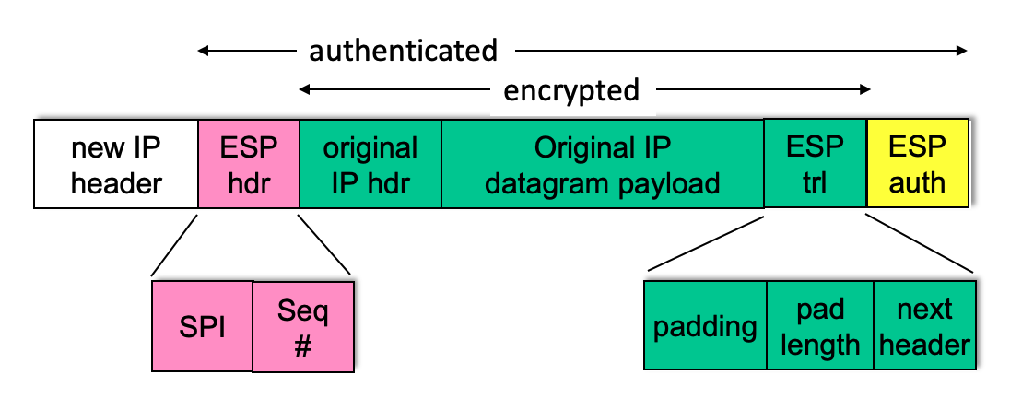
ESP tunnel mode: actions
payload
at R1:
appends ESP trailer to original datagram (which includes original header fields!)
encrypts result using algorithm & key specified by SA
appends ESP header to front of this encrypted quantity
creates authentication MAC using algorithm and key specified in SA
appends MAC forming payload
creates new IP header, new IP header fields, addresses to tunnel endpoint
R1
payload

Slide 89
IPsec sequence numbers
for new SA, sender initializes seq. # to 0
each time datagram is sent on SA:
sender increments seq # counter
places value in seq # field
goal:
prevent attacker from sniffing and replaying a packet
receipt of duplicate, authenticated IP packets may disrupt service
method:
destination checks for duplicates
doesn’t keep track of all received packets; instead uses a window

Slide 90
Security Policy Database (SPD)
IPsec security databases
Security Assoc. Database (SAD)
endpoint holds SA state in security association database (SAD)
when sending IPsec datagram, R1 accesses SAD to determine how to process datagram
when IPsec datagram arrives to R2, R2 examines SPI in IPsec datagram, indexes SAD with SPI, processing
datagram accordingly.
policy: for given datagram, sender needs to know if it should use IP sec
policy stored in security policy database (SPD)
needs to know which SA to use
may use: source and destination IP address; protocol number
SAD: “how” to do it
SPD: “what” to do

Slide 91
Summary: IPsec services
Trudy sits somewhere between R1, R2. she doesn’t know the keys
will Trudy be able to see original contents of datagram? How about source, dest IP address, transport protocol, application port?
flip bits without detection?
masquerade as R1 using R1’s IP address?
replay a datagram?

Slide 92
IKE: Internet Key Exchange
previous examples: manual establishment of IPsec SAs in IPsec endpoints:
Example SA:
SPI: 12345
Source IP: 200.168.1.100
Dest IP: 193.68.2.23
Protocol: ESP
Encryption algorithm: 3DES-cbc
HMAC algorithm: MD5
Encryption key: 0x7aeaca…
HMAC key:0xc0291f…
manual keying is impractical for VPN with 100s of endpoints
instead use IPsec IKE (Internet Key Exchange)

Slide 93
IKE: PSK and PKI
authentication (prove who you are) with either
pre-shared secret (PSK) or
with PKI (pubic/private keys and certificates).
PSK: both sides start with secret
run IKE to authenticate each other and to generate IPsec SAs (one in each direction), including encryption, authentication keys
PKI: both sides start with public/private key pair, certificate
run IKE to authenticate each other, obtain IPsec SAs (one in each direction).
similar with handshake in SSL.

Slide 94
IKE phases
IKE has two phases
phase 1: establish bi-directional IKE SA
note: IKE SA different from IPsec SA
aka ISAKMP security association
phase 2: ISAKMP is used to securely negotiate IPsec pair of SAs
phase 1 has two modes: aggressive mode and main mode
aggressive mode uses fewer messages
main mode provides identity protection and is more flexible

Slide 95
IPsec summary
IKE message exchange for algorithms, secret keys, SPI numbers
either AH or ESP protocol (or both)
AH provides integrity, source authentication
ESP protocol (with AH) additionally provides encryption
IPsec peers can be two end systems, two routers/firewalls, or a router/firewall and an end system

Slide 96
Chapter 8 outline
What is network security?
Principles of cryptography
Authentication, message integrity
Securing e-mail
Securing TCP connections: TLS
Network layer security: IPsec
Security in wireless and mobile networks
802.11 (WiFi)
4G/5G
Operational security: firewalls and IDS

Slide 97








802.11: authentication, encryption
mobile
AS
Authentication Server
AP
wired network
Arriving mobile must:
associate with access point: (establish) communication over wireless link
authenticate to network

Slide 98
802.11: authentication, encryption
mobile
AS
Authentication Server
AP
wired network
discovery of security capabilities
1
1
discovery of security capabilities:
AP advertises its presence, forms of authentication and encryption provided
device requests specific forms authentication, encryption desired
although device, AP already exchanging messages, device not yet authenticated, does not have encryption keys

Slide 99
802.11: authentication, encryption
mobile
AS
Authentication Server
AP
wired network
discovery of security capabilities
1
mutual authentication, key derivation
2
2
mutual authentication and shared symmetric key derivation:
AS, mobile already have shared common secret (e.g., password)
AS, mobile use shared secret, nonces (prevent relay attacks), cryptographic hashing (ensure message integrity) to authenticating each other
AS, mobile derive symmetric session key

Slide 100
802.11: WPA3 handshake
mobile
AS Authentication Server
Initial shared secret
Initial shared secret
Nonce_{AS}
derive session key K_{M-AP} using initial-shared-secret, Nonce_{AS}, Nonce_{M}
a
b
c
derive session key K_{M-AP} using initial shared secret , Nonce_{AS}, Nonce_{M}
Nonce_{M}, HMAC(f(K_{AS-M},Nonce_{AS)})
AS generates Nonce_{AS}, sends to mobile
mobile receives Nonce_{AS}
generates Nonce_{M}
generates symmetric shared session key K_{M-AP} using Nonce_{AS}, Nonce_{M}, and initial shared secret
sends Nonce_{M}, and HMAC-signed value using Nonce_{AS} and initial shared secret
AS derives symmetric shared session key K_{M-AP}
a
b
c

Slide 101
802.11: authentication, encryption
mobile
AS
Authentication Server
AP
wired network
discovery of security capabilities
1
mutual authentication, key derivation
2
Shared symmetric key distribution
3
3
shared symmetric session key distribution (e.g., for AES encryption)
same key derived at mobile, AS
AS informs AP of the shared symmetric session

Slide 102
802.11: authentication, encryption
mobile
AS
Authentication Server
AP
wired network
discovery of security capabilities
1
mutual authentication, key derivation
2
shared symmetric key distribution
3
encrypted communication over WiFi
4
4
encrypted communication between mobile and remote host via AP
same key derived at mobile, AS
AS informs AP of the shared symmetric session

Slide 103
802.11: authentication, encryption
mobile
AS
Authentication Server
AP
wired network
EAP TLS
EAP
EAP over LAN (EAPoL)
RADIUS
IEEE 802.11
UDP/IP
Extensible Authentication Protocol (EAP) [RFC 3748] defines end-to-end request/response protocol between mobile device, AS

Slide 104
Chapter 8 outline
What is network security?
Principles of cryptography
Authentication, message integrity
Securing e-mail
Securing TCP connections: TLS
Network layer security: IPsec
Security in wireless and mobile networks
802.11 (WiFi)
4G/5G
Operational security: firewalls and IDS

Slide 105
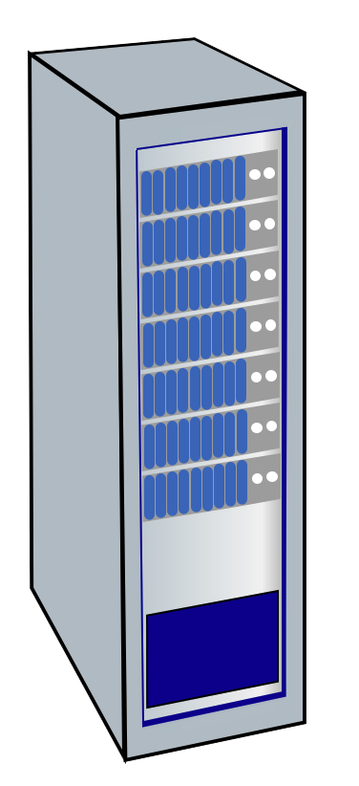


Authentication, encryption in 4G LTE
Home Subscriber Service (HSS)
Mobility Management Entity (MME)
mobile
Visited network
Home network
Base station (BS)
arriving mobile must:
associate with BS: (establish) communication over 4G wireless link
authenticate itself to network, and authenticate network
notable differences from WiFi
mobile’s SIMcard provides global identity, contains shared keys
services in visited network depend on (paid) service subscription in home network

Slide 106
Authentication, encryption in 4G LTE
Home Subscriber Service (HSS)
K
Mobility Management Entity (MME)
mobile
BS-M
K
HSS-M
K
Visited network
Home network
HSS-M
Base station (BS)
mobile, BS use derived session key K_{BS-M} to encrypt communications over 4G link
MME in visited network + HHS in home network, together play role of WiFi AS
ultimate authenticator is HSS
trust and business relationship between visited and home networks

Slide 107
Authentication, encryption in 4G LTE
Home Subscriber Service (HSS)
K
Mobility Management Entity (MME)
mobile
BS-M
K
HSS-M
K
Visited network
Home network
HSS-M
Base station (BS)
attach
attach
AUTH_REQ (IMSI, VN info)
a
authentication request to home network HSS
mobile sends attach message (containing its IMSI, visited network info) relayed from BS to visited MME to home HHS
IMSI identifies mobile’s home network
a

Slide 108
Authentication, encryption in 4G LTE
Home Subscriber Service (HSS)
K
Mobility Management Entity (MME)
mobile
BS-M
K
HSS-M
K
Visited network
Home network
HSS-M
Base station (BS)
attach
attach
AUTH_REQ (IMSI, VN info)
a
auth token
auth token
b
AUTH_RESP (auth token,xres_{HSS},keys)
HSS use shared-in-advance secret key, K_{HSS-M}, to derive authentication token, auth_token, and expected authentication response token, xres_{HSS}
auth_token contains info encrypted by HSS using K_{HSS-M} , allowing mobile to know that whoever computed auth_token knows shared-in-advance secret
mobile has authenticated network
visited HSS keeps xres_{HSS} for later use
b

Slide 109
Authentication, encryption in 4G LTE
Home Subscriber Service (HSS)
K
Mobility Management Entity (MME)
mobile
BS-M
K
HSS-M
K
Visited network
Home network
HSS-M
Base station (BS)
attach
attach
AUTH_REQ (IMSI, VN info)
a
auth token
auth token
b
res_{M}
AUTH_RESP (auth token,xres_{HSS},keys)
c
authentication response from mobile:
mobile computes res_{M} using its secret key to make same cryptographic calculation that HSS made to compute xres_{HSS} and sends res_{M} to MME
c

Slide 110
Authentication, encryption in 4G LTE
Home Subscriber Service (HSS)
K
Mobility Management Entity (MME)
mobile
BS-M
K
HSS-M
K
Visited network
Home network
HSS-M
Base station (BS)
attach
attach
AUTH_REQ (IMSI, VN info)
a
auth token
auth token
b
res_{M}
AUTH_RESP (auth token,xres_{HSS},keys)
c
OK, keys
OK
d
mobile is authenticated by network:
MMS compares mobile-computed value of res_{M} with the HSS-computed value of xres_{HSS} . If they match, mobile is authenticated ! (why?)
MMS informs BS that mobile is authenticated, generates keys for BS
d

Slide 111
Authentication, encryption in 4G LTE
Home Subscriber Service (HSS)
K
Mobility Management Entity (MME)
mobile
BS-M
K
HSS-M
K
Visited network
Home network
HSS-M
Base station (BS)
attach
attach
AUTH_REQ (IMSI, VN info)
a
auth token
auth token
b
res_{M}
AUTH_RESP (auth token,xres_{HSS},keys)
c
OK, keys
OK
d
e
mobile, BS determine keys for encrypting data, control frames over 4G wireless channel
AES can be used
key derivation
e

Slide 112
Authentication, encryption: from 4G to 5G
4G: MME in visited network makes authentication decision
5G: home network provides authentication decision
visited MME plays “middleman” role but can still reject
4G: uses shared-in-advance keys
5G: keys not shared in advance for IoT
4G: device IMSI transmitted in cleartext to BS
5G: public key crypto used to encrypt IMSI

Slide 113
Chapter 8 outline
What is network security?
Principles of cryptography
Authentication, message integrity
Securing e-mail
Securing TCP connections: TLS
Network layer security: IPsec
Security in wireless and mobile networks
Operational security: firewalls and IDS

Slide 114

Firewalls
firewall
isolates organization’s internal network from larger Internet, allowing some packets to pass, blocking others
administered
network
public
Internet
trusted “good guys”
untrusted “bad guys”
firewall

Slide 115
Firewalls: why
prevent denial of service attacks:
SYN flooding: attacker establishes many bogus TCP connections, no resources left for “real” connections
prevent illegal modification/access of internal data
e.g., attacker replaces CIA’s homepage with something else
allow only authorized access to inside network
set of authenticated users/hosts
three types of firewalls:
stateless packet filters
stateful packet filters
application gateways

Slide 116
Stateless packet filtering
Should arriving packet be allowed in? Departing packet let out?
internal network connected to Internet via router firewall
filters packet-by-packet, decision to forward/drop packet based on:
source IP address, destination IP address
TCP/UDP source, destination port numbers
ICMP message type
TCP SYN, ACK bits

Slide 117
Stateless packet filtering: example
Should arriving packet be allowed in? Departing packet let out?
example 1: block incoming and outgoing datagrams with IP protocol field = 17 and with either source or dest port = 23
result: all incoming, outgoing UDP flows and telnet connections are blocked
example 2: block inbound TCP segments with ACK=0
result: prevents external clients from making TCP connections with internal clients, but allows internal clients to connect to outside

Slide 118
Stateless packet filtering: more examples
Policy | Firewall Setting
no outside Web access | drop all outgoing packets to any IP address, port 80
no incoming TCP connections, except those for institution’s public Web server only. | drop all incoming TCP SYN packets to any IP except 130.207.244.203, port 80
prevent Web-radios from eating up the available bandwidth. | drop all incoming UDP packets - except DNS and router broadcasts.
prevent your network from being used for a smurf DoS attack. | drop all ICMP packets going to a “broadcast” address (e.g. 130.207.255.255)
prevent your network from being tracerouted | drop all outgoing ICMP TTL expired traffic

Slide 119
Access Control Lists
ACL: table of rules, applied top to bottom to incoming packets: (action, condition) pairs: looks like OpenFlow forwarding (Ch. 4)!
action | source address | dest address | protocol | source port | dest port | flag bit
allow | 222.22/16 | outside of 222.22/16 | TCP | > 1023 | 80 | any
allow | outside of 222.22/16 | 222.22/16 | TCP | 80 | > 1023 | ACK
allow | 222.22/16 | outside of 222.22/16 | UDP | > 1023 | 53 | ---
allow | outside of 222.22/16 | 222.22/16 | UDP | 53 | > 1023 | ----
deny | all | all | all | all | all | all

Slide 120
Stateful packet filtering
stateless packet filter: heavy handed tool
admits packets that “make no sense,” e.g., dest port = 80, ACK bit set, even though no TCP connection established:
action | source address | dest address | protocol | source port | dest port | flag bit
allow | outside of 222.22/16 | 222.22/16 | TCP | 80 | > 1023 | ACK
stateful packet filter: track status of every TCP connection
track connection setup (SYN), teardown (FIN): determine whether incoming, outgoing packets “makes sense”
timeout inactive connections at firewall: no longer admit packets

Slide 121
Stateful packet filtering
ACL augmented to indicate need to check connection state table before admitting packet
action | source address | dest address | proto | source port | dest port | flag bit | check connection
allow | 222.22/16 | outside of 222.22/16 | TCP | > 1023 | 80 | any
allow | outside of 222.22/16 | 222.22/16 | TCP | 80 | > 1023 | ACK | x
allow | 222.22/16 | outside of 222.22/16 | UDP | > 1023 | 53 | ---
allow | outside of 222.22/16 | 222.22/16 | UDP | 53 | > 1023 | ---- | x
deny | all | all | all | all | all | all

Slide 122
Application gateways
filter packets on application data as well as on IP/TCP/UDP fields.
example: allow select internal users to telnet outside
host-to-gateway
telnet session
application
gateway
router and filter
gateway-to-remote
host telnet session
1. require all telnet users to telnet through gateway.
2. for authorized users, gateway sets up telnet connection to dest host
gateway relays data between 2 connections
3. router filter blocks all telnet connections not originating from gateway

Slide 123
Limitations of firewalls, gateways
IP spoofing: router can’t know if data “really” comes from claimed source
if multiple apps need special treatment, each has own app. gateway
client software must know how to contact gateway
e.g., must set IP address of proxy in Web browser
filters often use all or nothing policy for UDP
tradeoff: degree of communication with outside world, level of security
many highly protected sites still suffer from attacks

Slide 124
Intrusion detection systems
packet filtering:
operates on TCP/IP headers only
no correlation check among sessions
IDS: intrusion detection system
deep packet inspection: look at packet contents (e.g., check character strings in packet against database of known virus, attack strings)
examine correlation among multiple packets
port scanning
network mapping
DoS attack

Slide 125
Intrusion detection systems
multiple IDSs: different types of checking at different locations
firewall
internal
network
Internet
IDS
sensors
Web
server
demilitarized
zone
DNS
server
FTP
server

Slide 126
Network Security (summary)
basic techniques…...
cryptography (symmetric and public key)
message integrity
end-point authentication
…. used in many different security scenarios
secure email
secure transport (TLS)
IP sec
802.11, 4G/5G
operational security: firewalls and IDS

